Slide 1


우리 FISA 2025.09.26
AI 엔지니어링 - 2차 기술세미나
컴퓨터는 어떻게 텍스트 이미지를 읽을까?
OCR 알아보기
발표자 : 김성현

Slide 2
목차
01. 주제 선택 배경
02. OCR이란 어떤 기술인가?
03. 여러가지 데이터로 OCR해보기
04. 결론 및 향후 방향성
Notes:
목차는 둘중에 하나 선택해서 써!!

Slide 3

목차
01
주제 선택 배경
02
OCR이란 어떤 기술인가?
03
여러가지 데이터로 OCR해보기
04
결론 및 향후 방향성
Notes:
목차는 둘중에 하나 선택해서 써!!

Slide 4
주제 선택 이유

Slide 5
01
주제 선택 배경

Slide 6

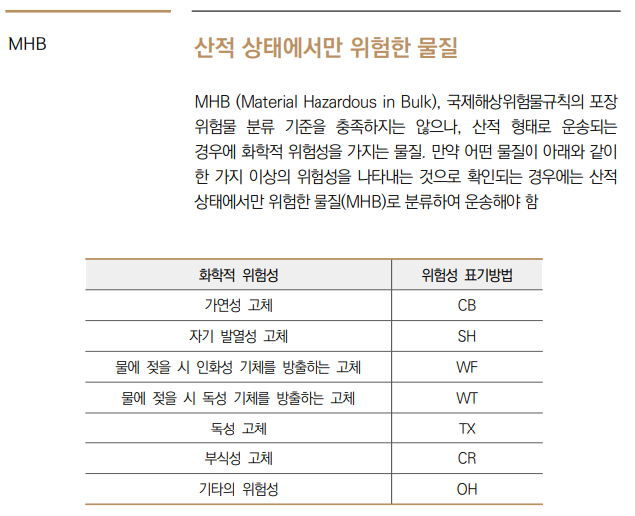
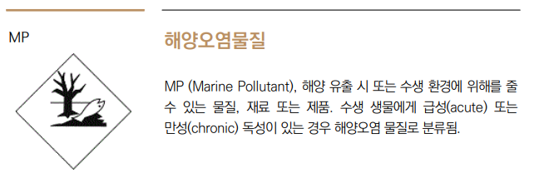
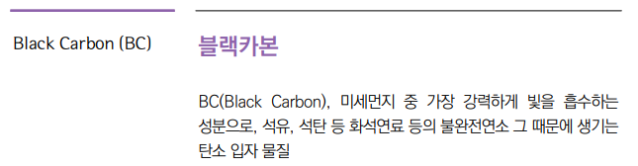
왜 OCR을??
PDF에서 텍스트를 추출해야 되는 상황

Slide 7
왜 OCR을??
PDF에서 텍스트를 추출해야 되는 상황

Slide 8
왜 OCR을??
PDF에서 텍스트를 추출해야 되는 상황

Slide 9
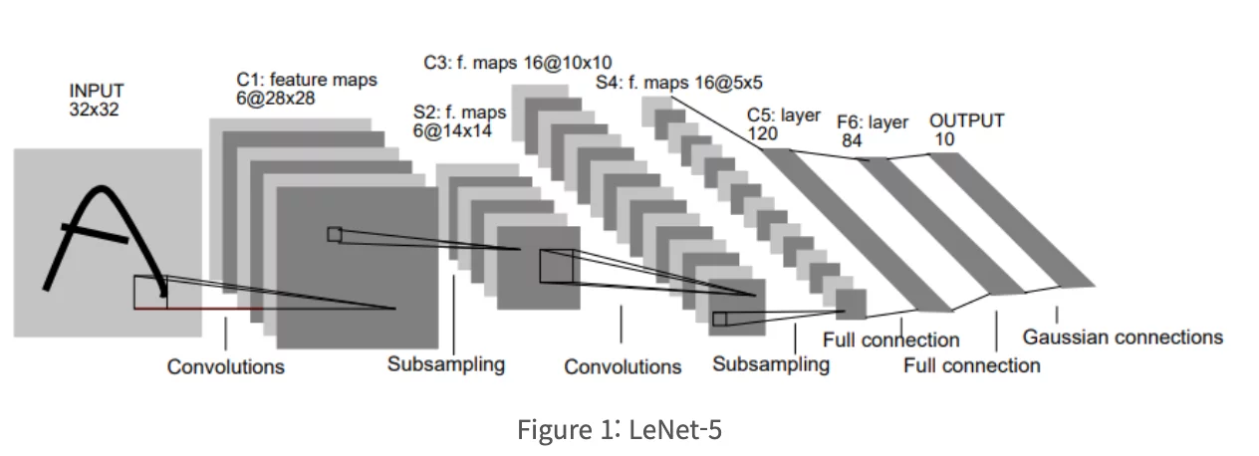
배운 CNN을 활용해서 충분히 가능!
https://healthyinsight.co.kr/%EC%9D%B4%EB%AF%B8%EC%A7%80-%EB%B6%84%EB%A5%98-cnn/

Slide 10
02
OCR이란
어떤 기술인가?

Slide 11
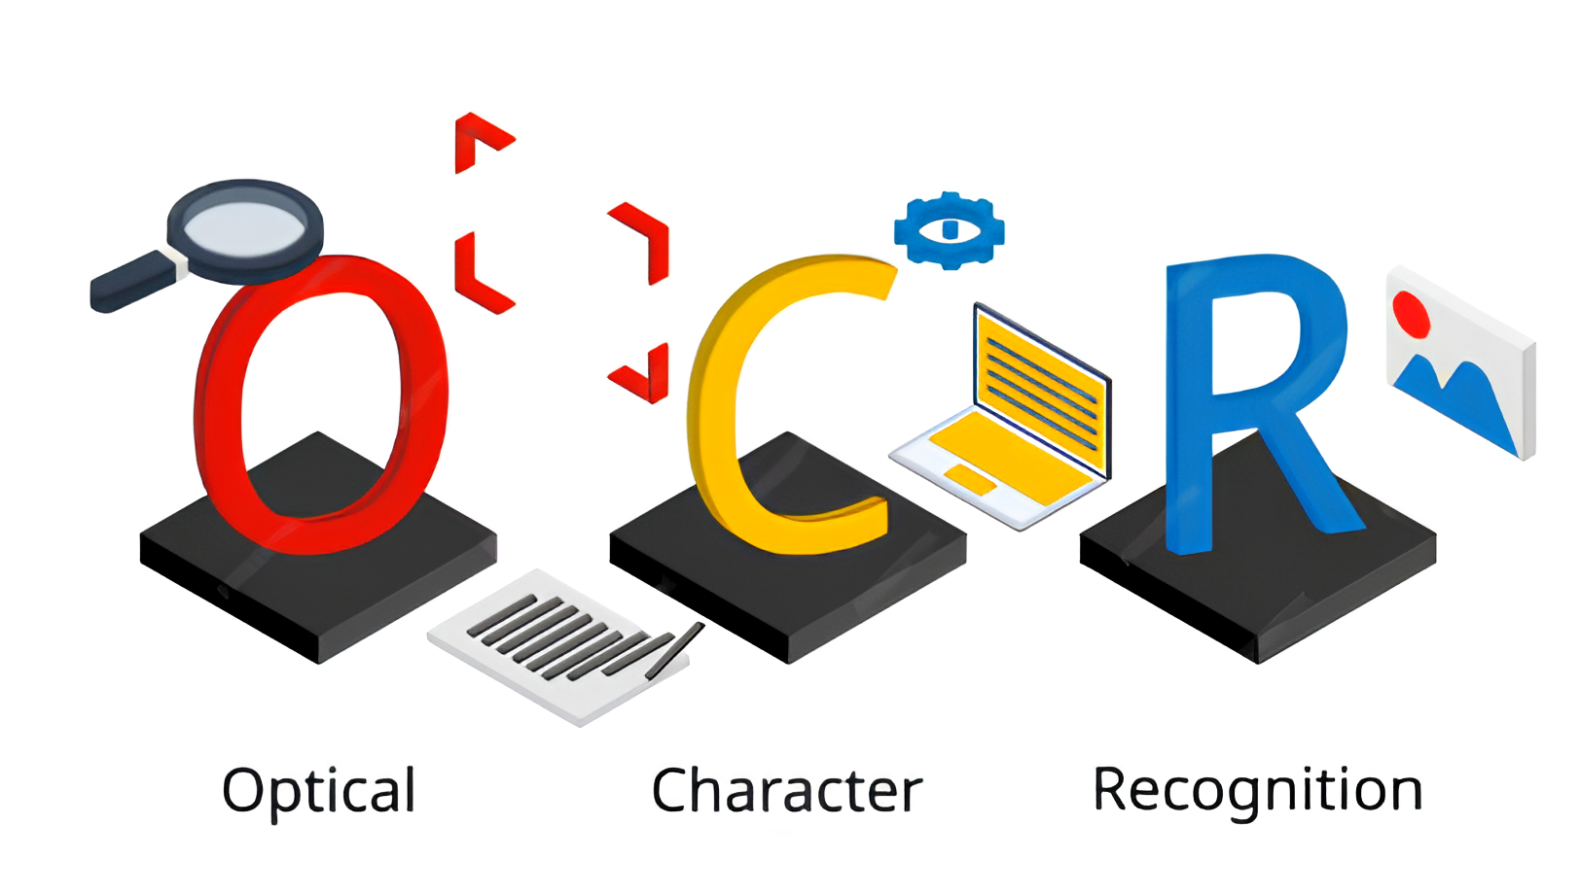
광학 문자 인식

Slide 12

기존 이미지 처리 방식과 차이점
CNN
C, A, T
OCR
CAT

Slide 13
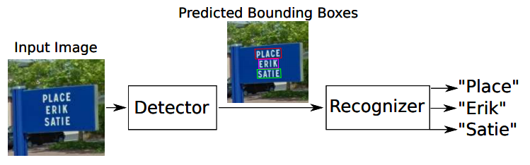
OCR의 동작 방식
1단계. Text Detection
2단계. Text Recognition
https://velog.io/@xpelqpdj0422/11.-OCR-%EA%B8%B0%EC%88%A0%EC%9D%98-%EA%B0%9C%EC%9A%94

Slide 14

핵심 엔진 Tesseract
https://github.com/tesseract-ocr/tesseract

Slide 15
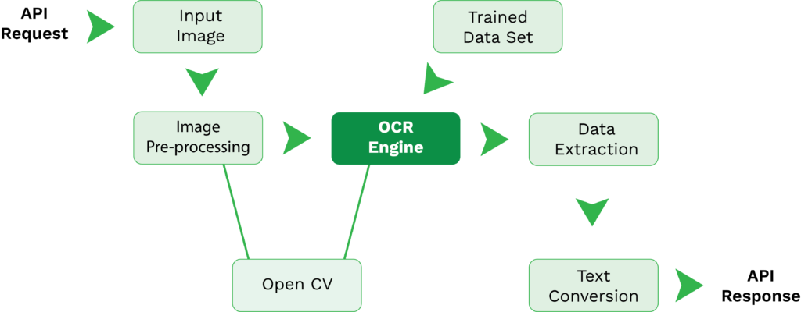
동작 방식
https://www.klippa.com/en/blog/information/tesseract-ocr/

Slide 16
동작 방식
https://www.klippa.com/en/blog/information/tesseract-ocr/

Slide 17
동작 방식
https://www.klippa.com/en/blog/information/tesseract-ocr/

Slide 18
동작 방식
https://www.klippa.com/en/blog/information/tesseract-ocr/

Slide 19
동작 방식
https://www.klippa.com/en/blog/information/tesseract-ocr/

Slide 20
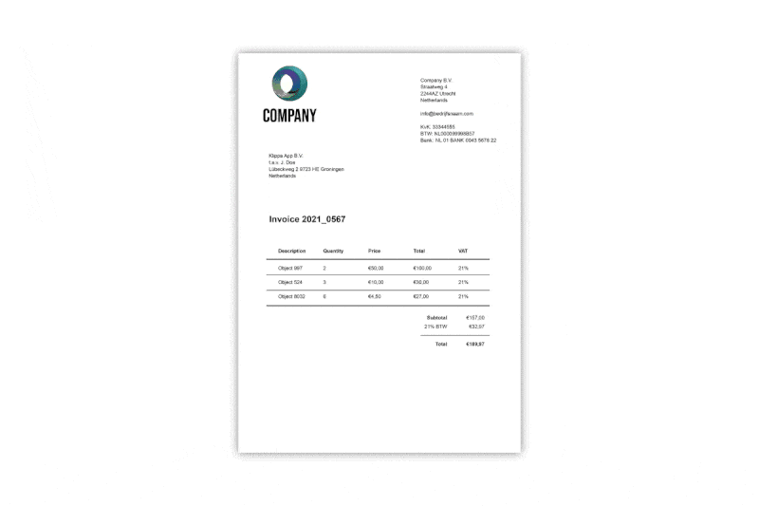

Slide 21
동작 방식
https://www.klippa.com/en/blog/information/tesseract-ocr/

Slide 22
동작 방식
https://www.klippa.com/en/blog/information/tesseract-ocr/

Slide 23
동작 방식
https://www.klippa.com/en/blog/information/tesseract-ocr/

Slide 24
동작 방식
https://www.klippa.com/en/blog/information/tesseract-ocr/

Slide 25
동작 방식
https://www.klippa.com/en/blog/information/tesseract-ocr/

Slide 26
03
여러가지 데이터로
OCR 해보기
Notes:
이것도 간지 둘중 하나 선택하기!!

Slide 27
제목기본틀

Slide 28


OCR 라이브러리
PyTesseract
EasyOCR
Unstructured

Slide 29
PyTesseract
PyTesseract
EasyOCR
Unstructured

Slide 30
PyTesseract
PyTesseract
EasyOCR
Unstructured

Slide 31
PyTesseract

Slide 32
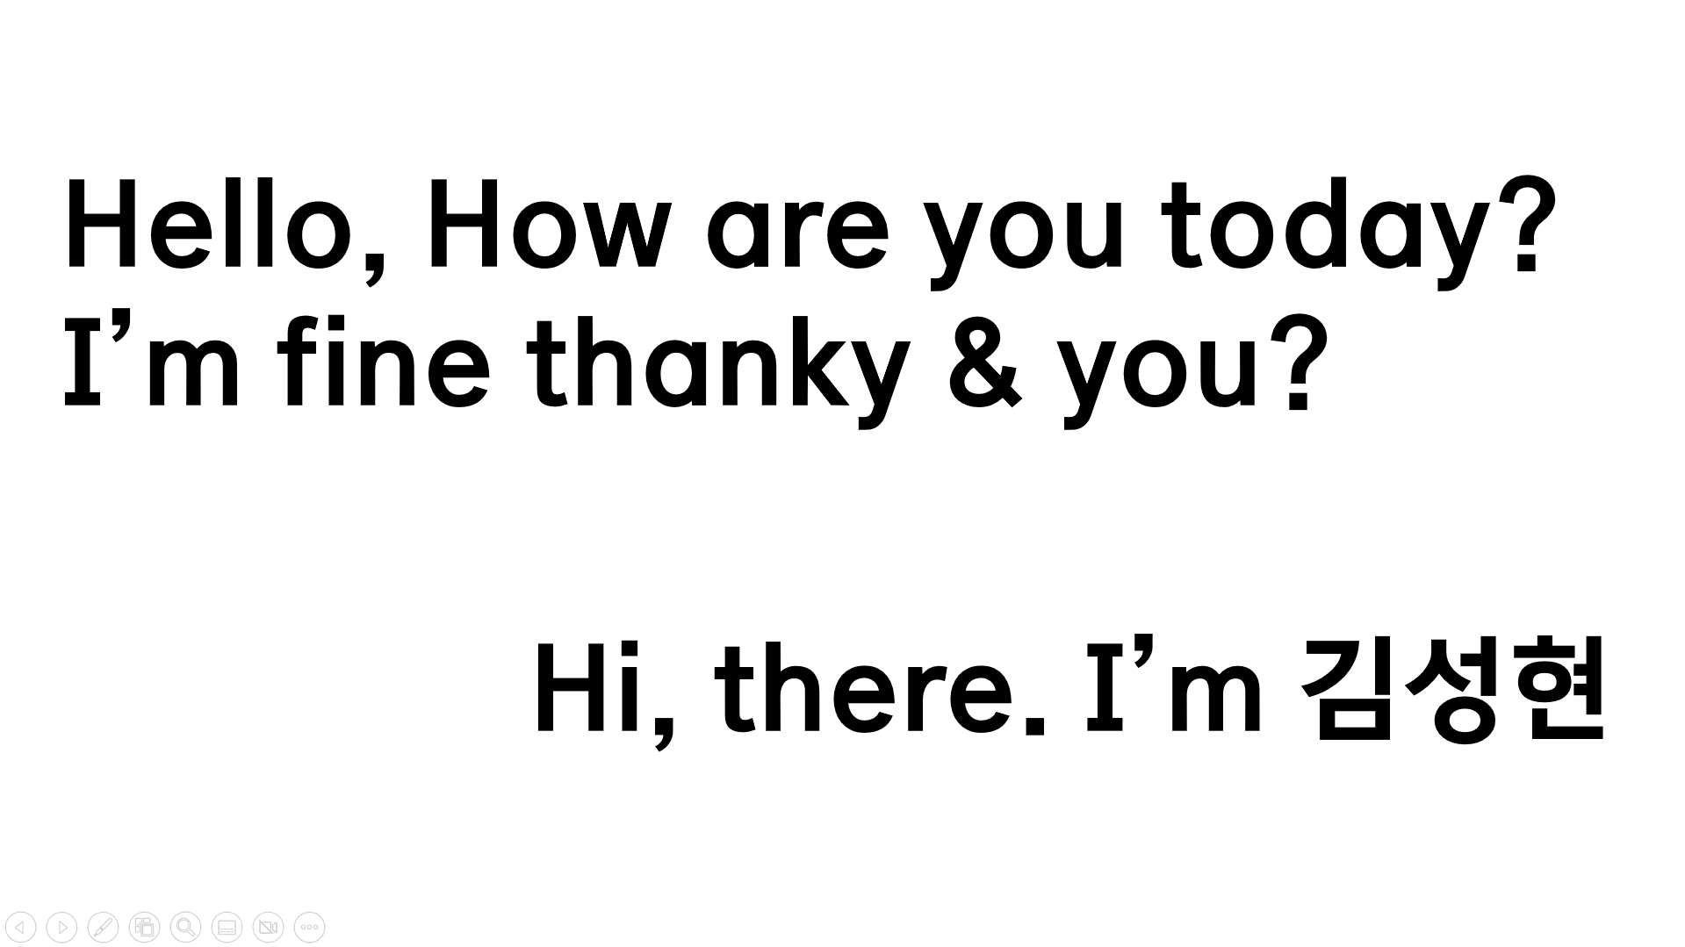
OCR Box
Test Image
 | Text | Confidence
0 |  | -1
1 |  | -1
2 |  | -1
3 |  | -1
4 | Hello, | 96
5 | How | 96
6 | are | 96
7 | you | 96
8 | today? | 95
9 |  | -1
10 | I’m | 83
11 | fine | 93
12 | thanky | 92
13 | & | 93
14 | you? | 96
15 |  | -1
16 |  | -1
17 |  | -1
18 | Hi, | 95
19 | there. | 87
20 | ‘m | 59
21 | ZY | 0

Slide 33
Test Image
OCR Box
 | Text | Confidence
0 |  | -1
1 |  | -1
2 |  | -1
3 |  | -1
4 | Hello, | 96
5 | How | 96
6 | are | 96
7 | you | 96
8 | today? | 95
9 |  | -1
10 | I’m | 83
11 | fine | 93
12 | thanky | 92
13 | & | 93
14 | you? | 96
15 |  | -1
16 |  | -1
17 |  | -1
18 | Hi, | 95
19 | there. | 87
20 | ‘m | 59
21 | ZY | 0

Slide 34
Test Image
OCR Box
 | Text | Confidence
0 |  | -1
1 |  | -1
2 |  | -1
3 |  | -1
4 | Hello, | 96
5 | How | 96
6 | are | 96
7 | you | 96
8 | today? | 95
9 |  | -1
10 | I’m | 83
11 | fine | 93
12 | thanky | 92
13 | & | 93
14 | you? | 96
15 |  | -1
16 |  | -1
17 |  | -1
18 | Hi, | 95
19 | there. | 87
20 | ‘m | 59
21 | ZY | 0

Slide 35
Test Image
OCR Box
 | Text | Confidence
0 |  | -1
1 |  | -1
2 |  | -1
3 |  | -1
4 | Hello, | 96
5 | How | 96
6 | are | 96
7 | you | 96
8 | today? | 95
9 |  | -1
10 | I’m | 83
11 | fine | 93
12 | thanky | 92
13 | & | 93
14 | you? | 96
15 |  | -1
16 |  | -1
17 |  | -1
18 | Hi, | 95
19 | there. | 87
20 | ‘m | 59
21 | ZY | 0

Slide 36
Test Image
OCR Box
 | Text | Confidence
0 |  | -1
1 |  | -1
2 |  | -1
3 |  | -1
4 | Hello, | 96
5 | How | 96
6 | are | 96
7 | you | 96
8 | today? | 95
9 |  | -1
10 | I’m | 83
11 | fine | 93
12 | thanky | 92
13 | & | 93
14 | you? | 96
15 |  | -1
16 |  | -1
17 |  | -1
18 | Hi, | 95
19 | there. | 87
20 | ‘m | 59
21 | ZY | 0

Slide 37
Test Image
 | Text | Confidence
0 |  | -1
1 |  | -1
2 |  | -1
3 |  | -1
4 | Hello, | 96
5 | How | 96
6 | are | 96
7 | you | 96
8 | today? | 95
9 |  | -1
10 | I’m | 83
11 | fine | 93
12 | thanky | 92
13 | & | 93
14 | you? | 96
15 |  | -1
16 |  | -1
17 |  | -1
18 | Hi, | 95
19 | there. | 87
20 | ‘m | 59
21 | ZY | 0
OCR Box

Slide 38
Test Image
 | Text | Confidence
0 |  | -1
1 |  | -1
2 |  | -1
3 |  | -1
4 | Hello, | 96
5 | How | 96
6 | are | 96
7 | you | 96
8 | today? | 95
9 |  | -1
10 | I’m | 83
11 | fine | 93
12 | thanky | 92
13 | & | 93
14 | you? | 96
15 |  | -1
16 |  | -1
17 |  | -1
18 | Hi, | 95
19 | there. | 87
20 | ‘m | 59
21 | ZY | 0
OCR Box

Slide 39
 | Text | Confidence
0 |  | -1
1 |  | -1
2 |  | -1
3 |  | -1
4 | Hello, | 96
5 | How | 96
6 | are | 96
7 | you | 96
8 | today? | 95
9 |  | -1
10 | I’m | 83
11 | fine | 93
12 | thanky | 92
13 | & | 93
14 | you? | 96
15 |  | -1
16 |  | -1
17 |  | -1
18 | Hi, | 95
19 | there. | 87
20 | ‘m | 59
21 | ZY | 0
OCR Box

Slide 40
 | Text | Confidence
0 |  | -1
1 |  | -1
2 |  | -1
3 |  | -1
4 | Hello, | 96
5 | How | 96
6 | are | 96
7 | you | 96
8 | today? | 95
9 |  | -1
10 | I’m | 83
11 | fine | 93
12 | thanky | 92
13 | & | 93
14 | you? | 96
15 |  | -1
16 |  | -1
17 |  | -1
18 | Hi, | 95
19 | there. | 87
20 | ‘m | 59
21 | ZY | 0
OCR Box

Slide 41
 | Text | Confidence
0 |  | -1
1 |  | -1
2 |  | -1
3 |  | -1
4 | Hello, | 96
5 | How | 96
6 | are | 96
7 | you | 96
8 | today? | 95
9 |  | -1
10 | I’m | 83
11 | fine | 93
12 | thanky | 92
13 | & | 93
14 | you? | 96
15 |  | -1
16 |  | -1
17 |  | -1
18 | Hi, | 95
19 | there. | 87
20 | ‘m | 59
21 | ZY | 0
OCR Box

Slide 42
 | Text | Confidence
0 |  | -1
1 |  | -1
2 |  | -1
3 |  | -1
4 | Hello, | 96
5 | How | 96
6 | are | 96
7 | you | 96
8 | today? | 95
9 |  | -1
10 | I’m | 83
11 | fine | 93
12 | thanky | 92
13 | & | 93
14 | you? | 96
15 |  | -1
16 |  | -1
17 |  | -1
18 | Hi, | 95
19 | there. | 87
20 | ‘m | 59
21 | ZY | 0
OCR Box

Slide 43
 | Text | Confidence
0 |  | -1
1 |  | -1
2 |  | -1
3 |  | -1
4 | Hello, | 96
5 | How | 96
6 | are | 96
7 | you | 96
8 | today? | 95
9 |  | -1
10 | I’m | 83
11 | fine | 93
12 | thanky | 92
13 | & | 93
14 | you? | 96
15 |  | -1
16 |  | -1
17 |  | -1
18 | Hi, | 95
19 | there. | 87
20 | ‘m | 59
21 | ZY | 0
OCR Box

Slide 44
 | Text | Confidence
0 |  | -1
1 |  | -1
2 |  | -1
3 |  | -1
4 | Hello, | 96
5 | How | 96
6 | are | 96
7 | you | 96
8 | today? | 95
9 |  | -1
10 | I’m | 83
11 | fine | 93
12 | thanky | 92
13 | & | 93
14 | you? | 96
15 |  | -1
16 |  | -1
17 |  | -1
18 | Hi, | 95
19 | there. | 87
20 | ‘m | 59
21 | ZY | 0
OCR Box

Slide 45
 | Text | Confidence
0 |  | -1
1 |  | -1
2 |  | -1
3 |  | -1
4 | Hello, | 96
5 | How | 96
6 | are | 96
7 | you | 96
8 | today? | 95
9 |  | -1
10 | I’m | 83
11 | fine | 93
12 | thanky | 92
13 | & | 93
14 | you? | 96
15 |  | -1
16 |  | -1
17 |  | -1
18 | Hi, | 95
19 | there. | 87
20 | ‘m | 59
21 | ZY | 0
OCR Box

Slide 46
 | Text | Confidence
0 |  | -1
1 |  | -1
2 |  | -1
3 |  | -1
4 | Hello, | 96
5 | How | 96
6 | are | 96
7 | you | 96
8 | today? | 95
9 |  | -1
10 | I’m | 83
11 | fine | 93
12 | thanky | 92
13 | & | 93
14 | you? | 96
15 |  | -1
16 |  | -1
17 |  | -1
18 | Hi, | 95
19 | there. | 87
20 | ‘m | 59
21 | ZY | 0
OCR Box

Slide 47
 | Text | Confidence
0 |  | -1
1 |  | -1
2 |  | -1
3 |  | -1
4 | Hello, | 96
5 | How | 96
6 | are | 96
7 | you | 96
8 | today? | 95
9 |  | -1
10 | I’m | 83
11 | fine | 93
12 | thanky | 92
13 | & | 93
14 | you? | 96
15 |  | -1
16 |  | -1
17 |  | -1
18 | Hi, | 95
19 | there. | 87
20 | ‘m | 59
21 | ZY | 0
OCR Box

Slide 48
 | Text | Confidence
0 |  | -1
1 |  | -1
2 |  | -1
3 |  | -1
4 | Hello, | 96
5 | How | 96
6 | are | 96
7 | you | 96
8 | today? | 95
9 |  | -1
10 | I’m | 83
11 | fine | 93
12 | thanky | 92
13 | & | 93
14 | you? | 96
15 |  | -1
16 |  | -1
17 |  | -1
18 | Hi, | 95
19 | there. | 87
20 | ‘m | 59
21 | ZY | 0
OCR Box

Slide 49
 | Text | Confidence
0 |  | -1
1 |  | -1
2 |  | -1
3 |  | -1
4 | Hello, | 96
5 | How | 96
6 | are | 96
7 | you | 96
8 | today? | 95
9 |  | -1
10 | I’m | 83
11 | fine | 93
12 | thanky | 92
13 | & | 93
14 | you? | 96
15 |  | -1
16 |  | -1
17 |  | -1
18 | Hi, | 95
19 | there. | 87
20 | ‘m | 59
21 | ZY | 0
OCR Box

Slide 50
 | Text | Confidence
0 |  | -1
1 |  | -1
2 |  | -1
3 |  | -1
4 | Hello, | 96
5 | How | 96
6 | are | 96
7 | you | 96
8 | today? | 95
9 |  | -1
10 | I’m | 83
11 | fine | 93
12 | thanky | 92
13 | & | 93
14 | you? | 96
15 |  | -1
16 |  | -1
17 |  | -1
18 | Hi, | 95
19 | there. | 87
20 | ‘m | 59
21 | ZY | 0
Text Extraction
OCR Box

Slide 51
 | Text | Confidence
0 |  | -1
1 |  | -1
2 |  | -1
3 |  | -1
4 | Hello, | 96
5 | How | 96
6 | are | 96
7 | you | 96
8 | today? | 95
9 |  | -1
10 | I’m | 83
11 | fine | 93
12 | thanky | 92
13 | & | 93
14 | you? | 96
15 |  | -1
16 |  | -1
17 |  | -1
18 | Hi, | 95
19 | there. | 87
20 | ‘m | 59
21 | ZY | 0
OCR Box
Text Extraction

Slide 52
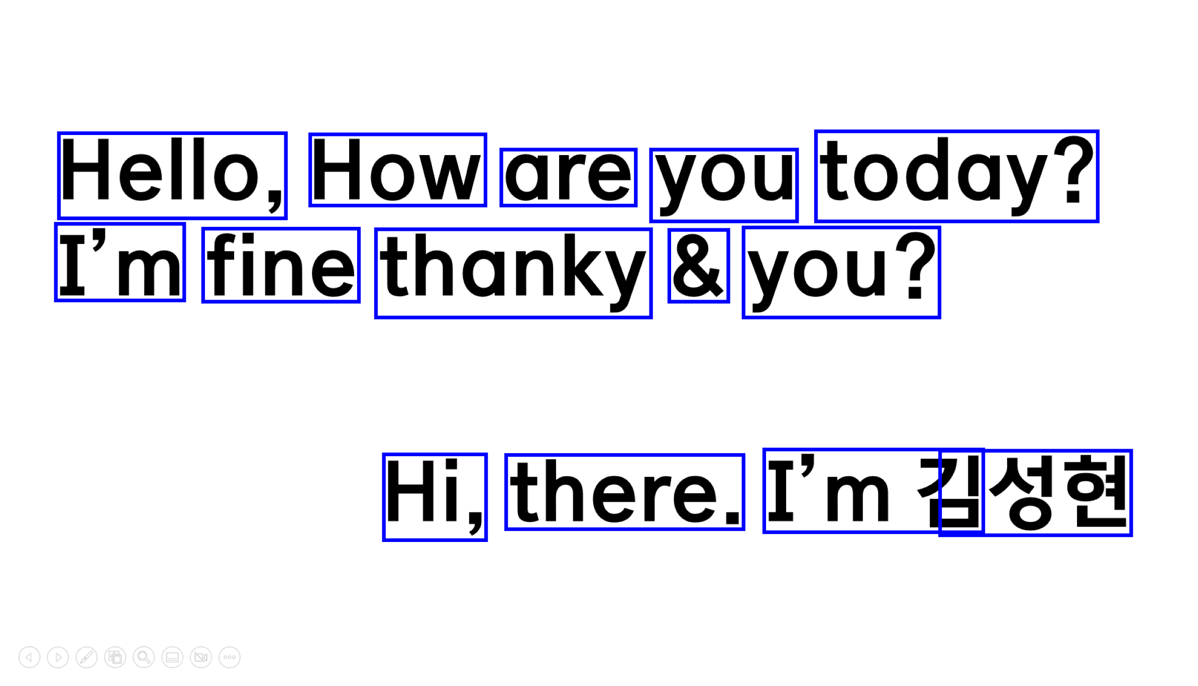
 | Text | Confidence
0 |  | -1
1 |  | -1
2 |  | -1
3 |  | -1
4 | Hello, | 96
5 | How | 96
6 | are | 96
7 | you | 96
8 | today? | 95
9 |  | -1
10 | I’m | 83
11 | fine | 93
12 | thanky | 92
13 | & | 93
14 | you? | 96
15 |  | -1
16 |  | -1
17 |  | -1
18 | Hi, | 95
19 | there. | 87
20 | ‘m | 59
21 | ZY | 0
OCR Box
Text Extraction
Hello, How are you today?
I’m fine thanky & you?
Hi, there. ’m 김성현

Slide 53
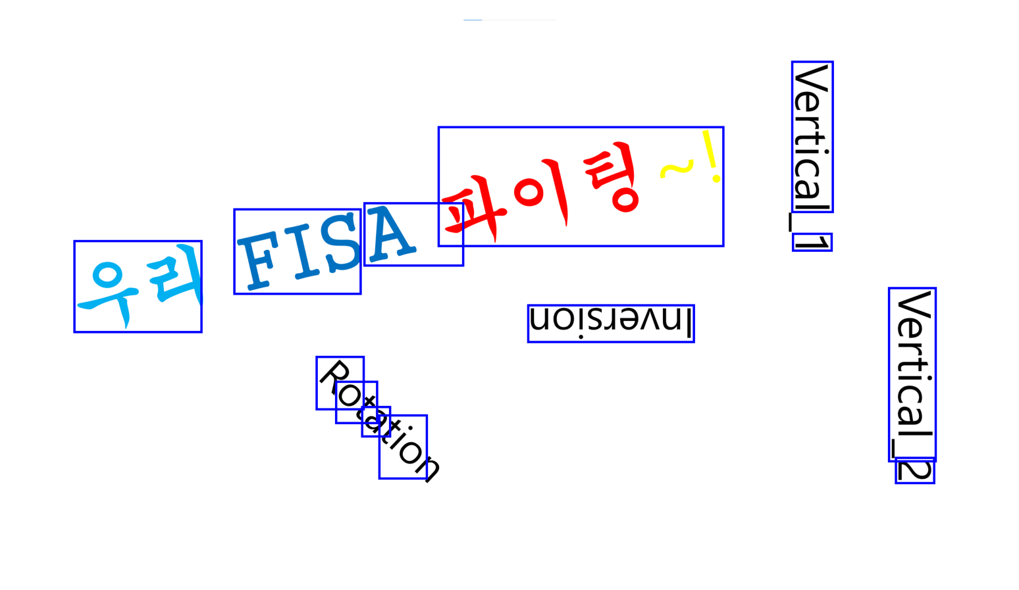
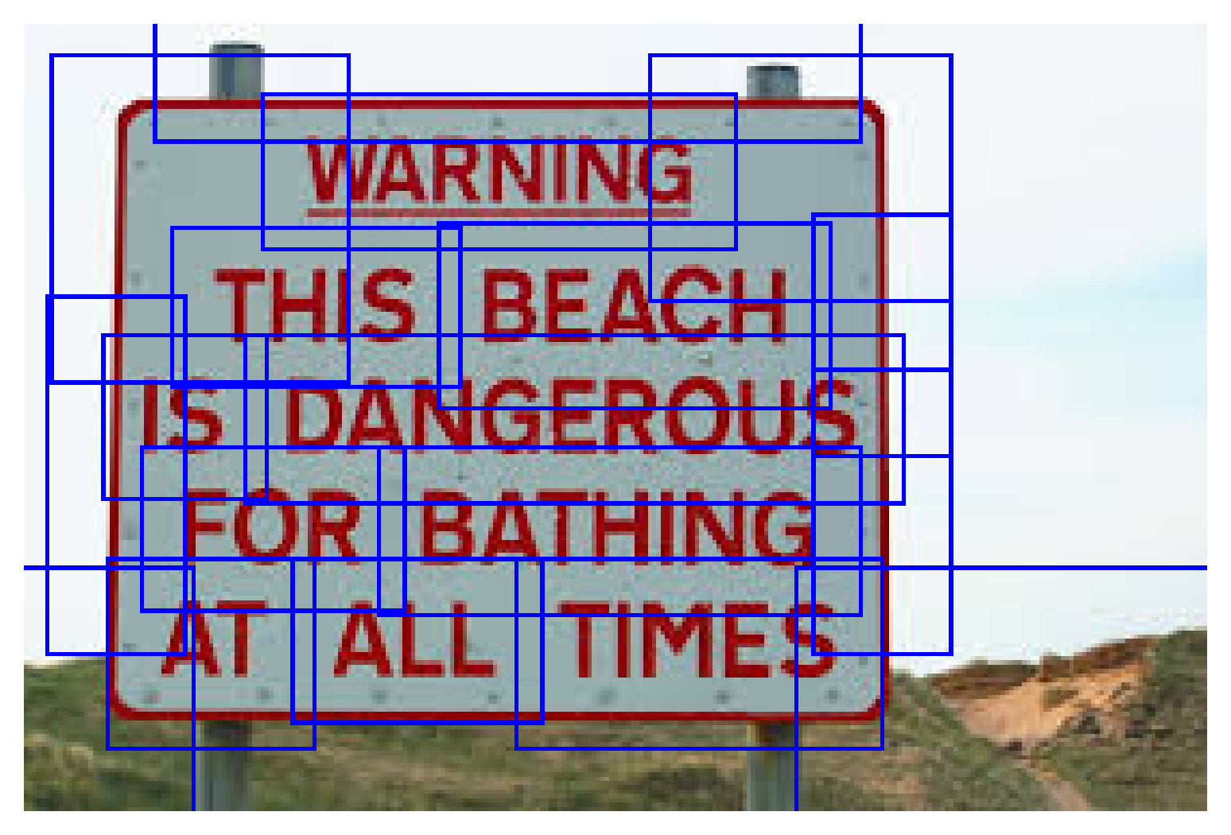
PyTesseract의 한계점

Slide 54
PyTesseract
PyTesseract
EasyOCR
Unstructured

Slide 55
EasyOCR

Slide 56
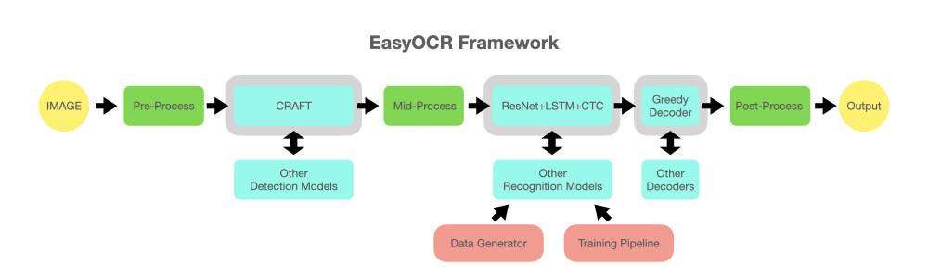
EasyOCR

Slide 57
PyTesseract
PyTesseract
EasyOCR
Unstructured

Slide 58
Unstructured Partioning

Slide 59
04
결론 및 향후 방향성

Slide 60
성능 향상을 위한 이미지 전처리

Slide 61
현재 OCR의 한계점

Slide 62
이후.. 수집한 데이터는?

Slide 63
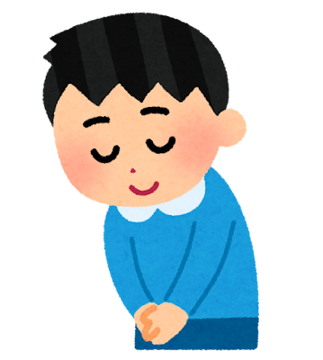
감사합니다 :>
Notes:
이거는 오빠가 알아서 꾸며도 될것같앙!!

